Slide 1
Sampling Methods
© McGraw Hill LLC. All rights reserved. No reproduction or distribution without the prior written consent of McGraw Hill LLC.

Slide 2

Target Population
Step 1: Define the target population.
Step 2: Define the sample frame (is there a list?)
Step 3: Take a sample? Or attempt a census?

Slide 3
Why Sample?
That's right – a sample can be both cheaper and more accurate than an attempted census!
Lower cost
Improved accuracy
Destructive testing, such as
Light bulb life (hours until failure)
5 mph crash car bumper tests (damage cost)
Perishable data (e.g., fresh fish inspection)
Timely data is required (e.g., political polls)
Large, dispersed population (e.g., seat belt usage)

Slide 4
Why Census?
If the population is small or if data are already in a PC database, why take a sample?
Computer database exists
Population is small and accessible
Legal requirements
U.S. Census (national headcount)
Bank cash (cash drawer balance)
Money is no constraint (rare)
Time is no constraint (rare)

Slide 5
Which Goal?
Descriptive (to get a general overview)
Percent of HMO patients who arrive late
Average tip per customer in a restaurant
Vaccination rates over time
Inferential (to estimate a parameter)
Mean insurance claim amount for angioplasty
Average days between billing and payment
Traffic count at a busy intersection

Slide 6
Inference
Population
μ = $79,370
σ = $6,771
N = 125,000
Example What is the average salary of an information security analyst? We sample because the population is large and hard to reach.
Sample
= $78,545
s = $6,958
n = 100

Slide 7
Sampling Methods
Simple random sample
List of population items must be available
Random numbers are used to choose items
Each item has same chance of being selected
Systematic sample
Continuous process (no list)
Non-enumerable population (no list)
Choose every k^{th} item (e.g., every 10th voter at poll exit)
Use a random starting point (e.g., the 8th voter)
Unbiased unless data are in non-random order

Slide 8
Sampling Methods
Stratified sample
Each stratum is a defined population subgroup (e.g., male/female)
May be many strata (e.g., gender, race, occupation)
Weight sample estimates by strata size (strata % must be known)
Corrects for possible under-representation of groups
Cluster sample
Like stratification except based on geography (e.g., school districts)
Two-stage is common (random cluster, random items in cluster)
Reduces travel cost for in-person interviews

Slide 9
Sampling Methods
Judgment sample
Experts in the field select the sample (e.g., which firms)
Utilizes domain knowledge of experts (e.g., software engineers)
May avoid wasting time on atypical or unimportant respondents
But introduces subjectivity
Convenience sample
Ask co-workers opinions "because they're handy"
Using data that happens to exist already
Subjective
Unknowable biases
Alas – some key business decisions are made this way!

Slide 10
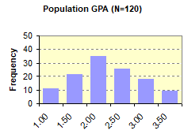
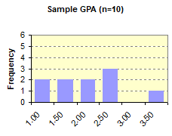
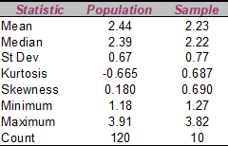
Simple Random Sample
Method Here are GPAs of 120 college freshmen seated in a classroom. Ten students were sampled by choosing the row and column at random. Sampled GPAs are highlighted. How well did the sample statistics and histograms match the population?
Note If you chose the sample, you might avoid adjacent items or try to include each row or column. But that would not be random.

Slide 11
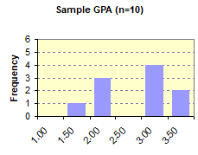
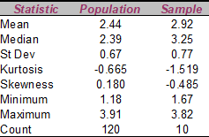
Systematic Sample
Method Data are the GPAs of college freshmen in a classroom. Choose 10 at random by picking every 12th student starting in row 5, column 1 and going down and across. Sampled GPAs are highlighted. How well do the sample statistics and histograms match the population?
Note Although this sample happens to give poor estimates, the systematic method is not to blame. It's just sampling error.

Slide 12
Cluster Sample
Method As a senior project, a team of political science students plans to conduct in-depth video interviews with dorm students to ascertain their views and information sources on an upcoming election. Each interview requires 15 minutes. They require a sample of 20 students. There are 11 dorms. To save interview room setup time, they choose 4 dorms at random and select 5 at random students in each dorm. This is a two-stage cluster sample.

Slide 13
Stratified Sample
Method A stratum (plural strata) is a specific subgroup of individuals defined by a characteristic such as age or race or gender (e.g., black women under age 30). A random sample may not accurately reflect all population strata. Stratified sampling seeks to sample individuals within each stratum so as to ensure an accurate representation of the population.
But … We often do not know the true population proportions, making a priori stratification impossible.
Moreover … The number strata can be huge, depending on how we define the strata. For example, the U.S. Census has 13 categories of ethnicity.
For example … If we arbitrarily define 6 genders, 10 age groups, and 13 ethnicities, there are 6 × 10 × 13 = 780 strata. A sample of 20 individuals in each stratum would require n = 15,600.

Slide 14
Stratified Sample
Workaround Because we often do not know the true population proportions (making a priori stratification impossible) and our survey budget constrains our sample size, how can we ensure fair estimation of each stratum? One workaround is to take a random sample that we can afford and then drastically simplify our definitions of strata so that enough individuals are sampled within each stratum. If population proportions are known (e.g., from prior research) we can form an overall estimate of a parameter (e.g., Covid-19 vaccination rates) after taking the sample by weighting each individual stratum estimate by its subgroup proportion.
There is no free lunch. We can’t always break down the data as much as we’d like.
For example … Even if we limit ourselves to only 2 genders, 4 age groups, and 3 ethnicities, we still have 2 × 4 × 3 = 24 strata. Even if the sample is large, we may still have enough individuals in each stratum!

Slide 15
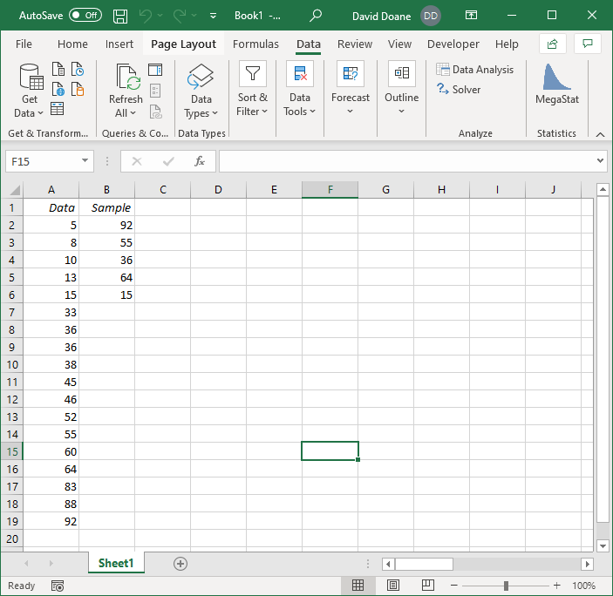
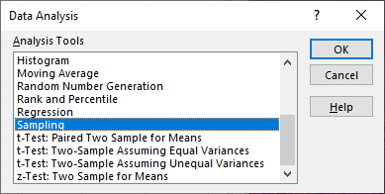
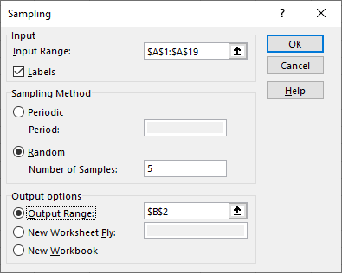
Sampling: Excel
Step 1. Click Data Analysis and choose Sampling.
Step 2. Enter data range, sample size, method (simple or periodic), and location for sample.

Slide 16
Sampling: R
In this example, we use R to create a data vector (alternatively, you could import a data column from Excel) and then sample it using the R function sample().
Syntax: sample(x, size, replace = FALSE, prob = NULL)
The prob option (omitted here) lets you specify sample weights
> # create data vector
> x=c(5,8,10,13,15,33,36,36,38,45,46,52,55,60,64,83,88,92)
> # take sample of 5 with replacement
> # enter FALSE if without replacement
> y=sample(x, 5, TRUE)
> # display the sample
> y
[1] 45 52 55 5 8

Slide 17
Random Data: R
Example 1: Create 25 random integers between 1 and 999.
> sample(1:999,25)
[1] 294 358 409 766 760 927 513 185 885 29 444 274 187 828 709 108 749 9
[19] 887 874 653 912 696 611 661
Example 2: Create 25 decimal observations from a normal distribution
with mean 100 and standard deviation 15. Round them to integers.
> Data1=rnorm(25,100,15) # Generate 25 random N(100,15)
> Data1 # list the data we have created
[1] 105.78153 112.62881 97.86053 95.25282 98.39782 88.48118 78.23761
[8] 95.86220 110.26956 118.48021 98.41509 116.24194 102.59046 119.65684
[15] 70.61914 112.47272 104.25433 99.06648 111.05391 97.01341 128.98725
[22] 105.95539 79.86504 62.50125 66.75198
> Data2= round(Data1,0) # round the sample data into integers
> Data2
[1] 106 113 98 95 98 88 78 96 110 118 98 116 103 120 71 112 104 99
[19] 111 97 129 106 80 63 67

Slide 18
Bottom Line
Do a cost/benefit before sampling.
Define the purpose before you plunge.
It may pay to seek expert advice for
the sampling plan.
the sample sizes required.
analysis of the sample.

